Slide 1

Project 4: Machine Learning
Team #7: Michael Herold, Ralph Samer

Slide 2
Recap
Task
Automatic tagging of unseen resources
Data set
StackExchange Data Dump from March, ‘16
programmers.stackexchange.com
Two approaches
Unsupervised: clustering
Supervised: classification
Total number of …
Posts | 38,315
Tags | 1,614
Notes:
2

Slide 3
Preprocessing
Goal
Filter noise, reduce dimensionality
Posts
Filter posts by score threshold (0)
Add accepted answer
Remove HTML, code, URLs, stop words
Merge synonym words
Identify tag occurrences (important features)
Stemming
Tags
Merge similar tags
Remove less frequent tags
Notes:
3

Slide 4
Feature Engineering
Two approaches:
TF-IDF: word occurrences as features
Information theoretical approach: 6 features for a document-tag pair
Does the tag occur in the title?
Does the tag occur in the body?
Do all parts of the tag split by hyphens occur in the title?
Do all parts of the tag split by hyphens occur in the body?
Title PMI: sum over all PMI for a word-tag pair
Body PMI
Notes:
4

Slide 5
Model Selection
3-fold Cross Validation
Problem
Multi-Class: more than 2 tags
Multi-Label: average tags/post = 2.68
Approach
Choose proper estimator
GridSearch: find best fitting hyperparameters
OneVsRestClassifier: one binary classifier per tag
Dataset
Training
Test
Train
Train
Test
1 fold
Test
Train
Train
2 fold
Train
Test
Train
3 fold
Notes:
5

Slide 6
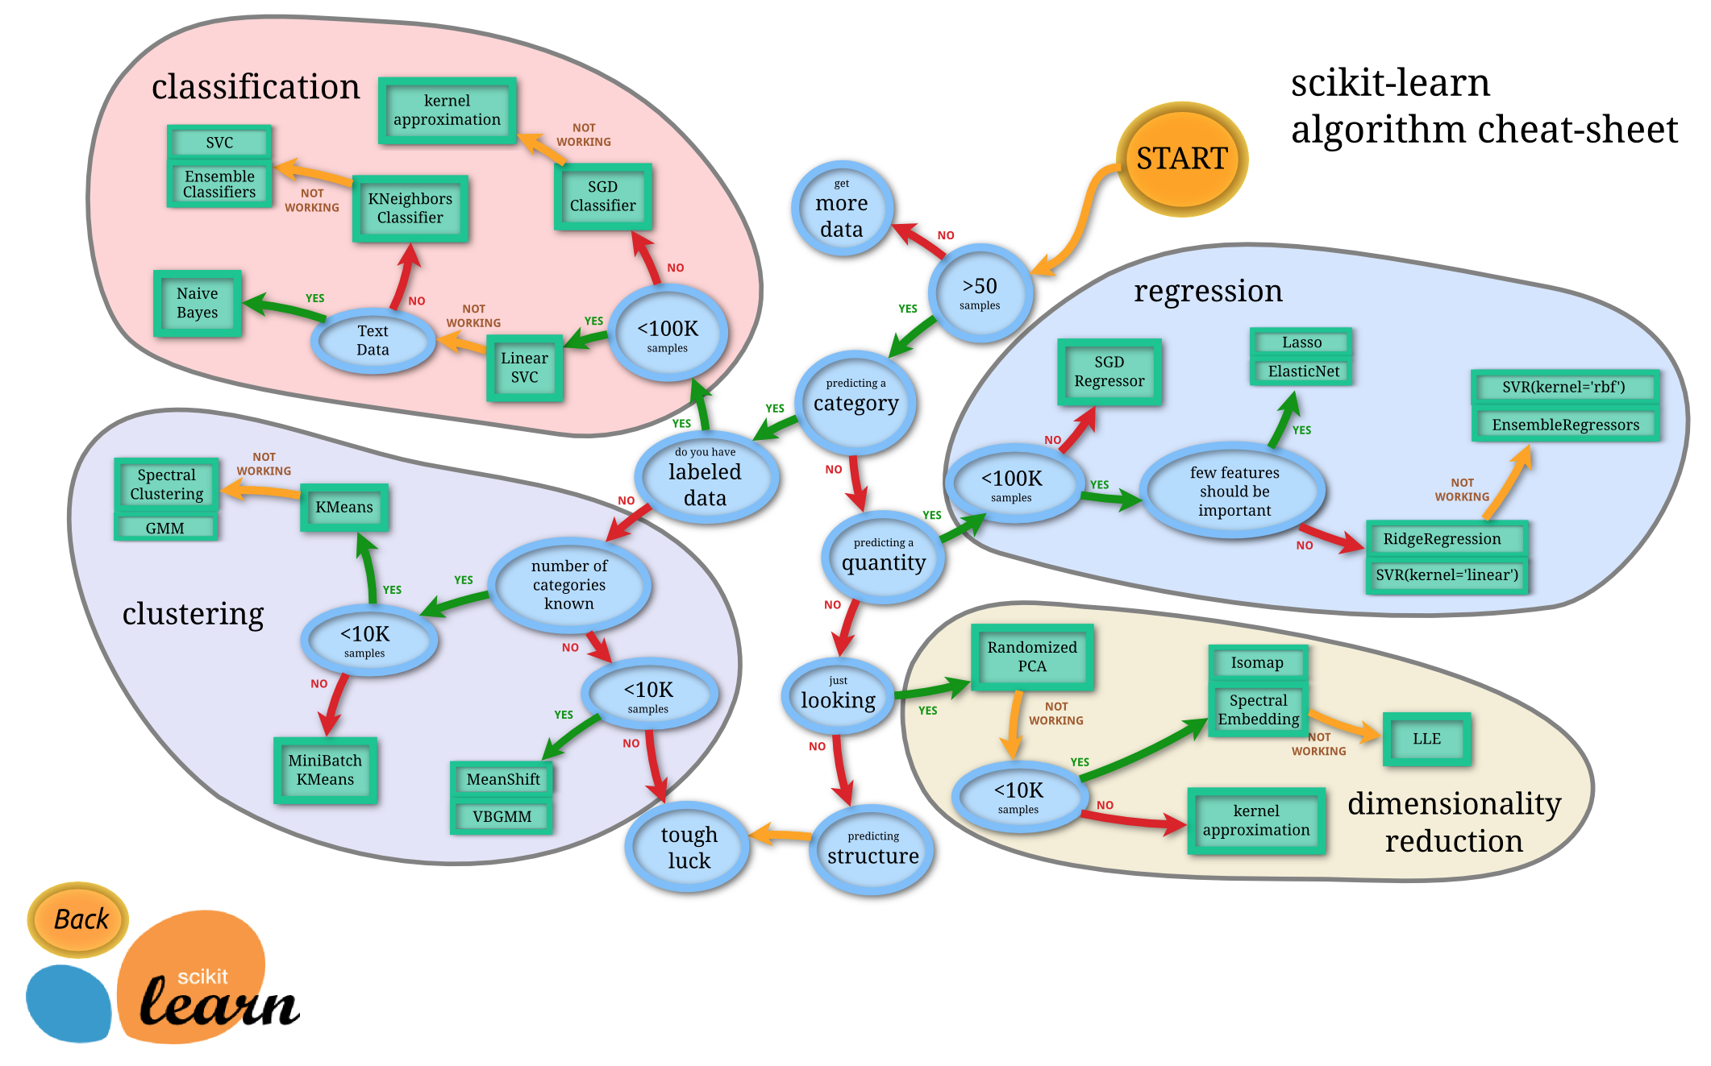
Notes:
6

Slide 7
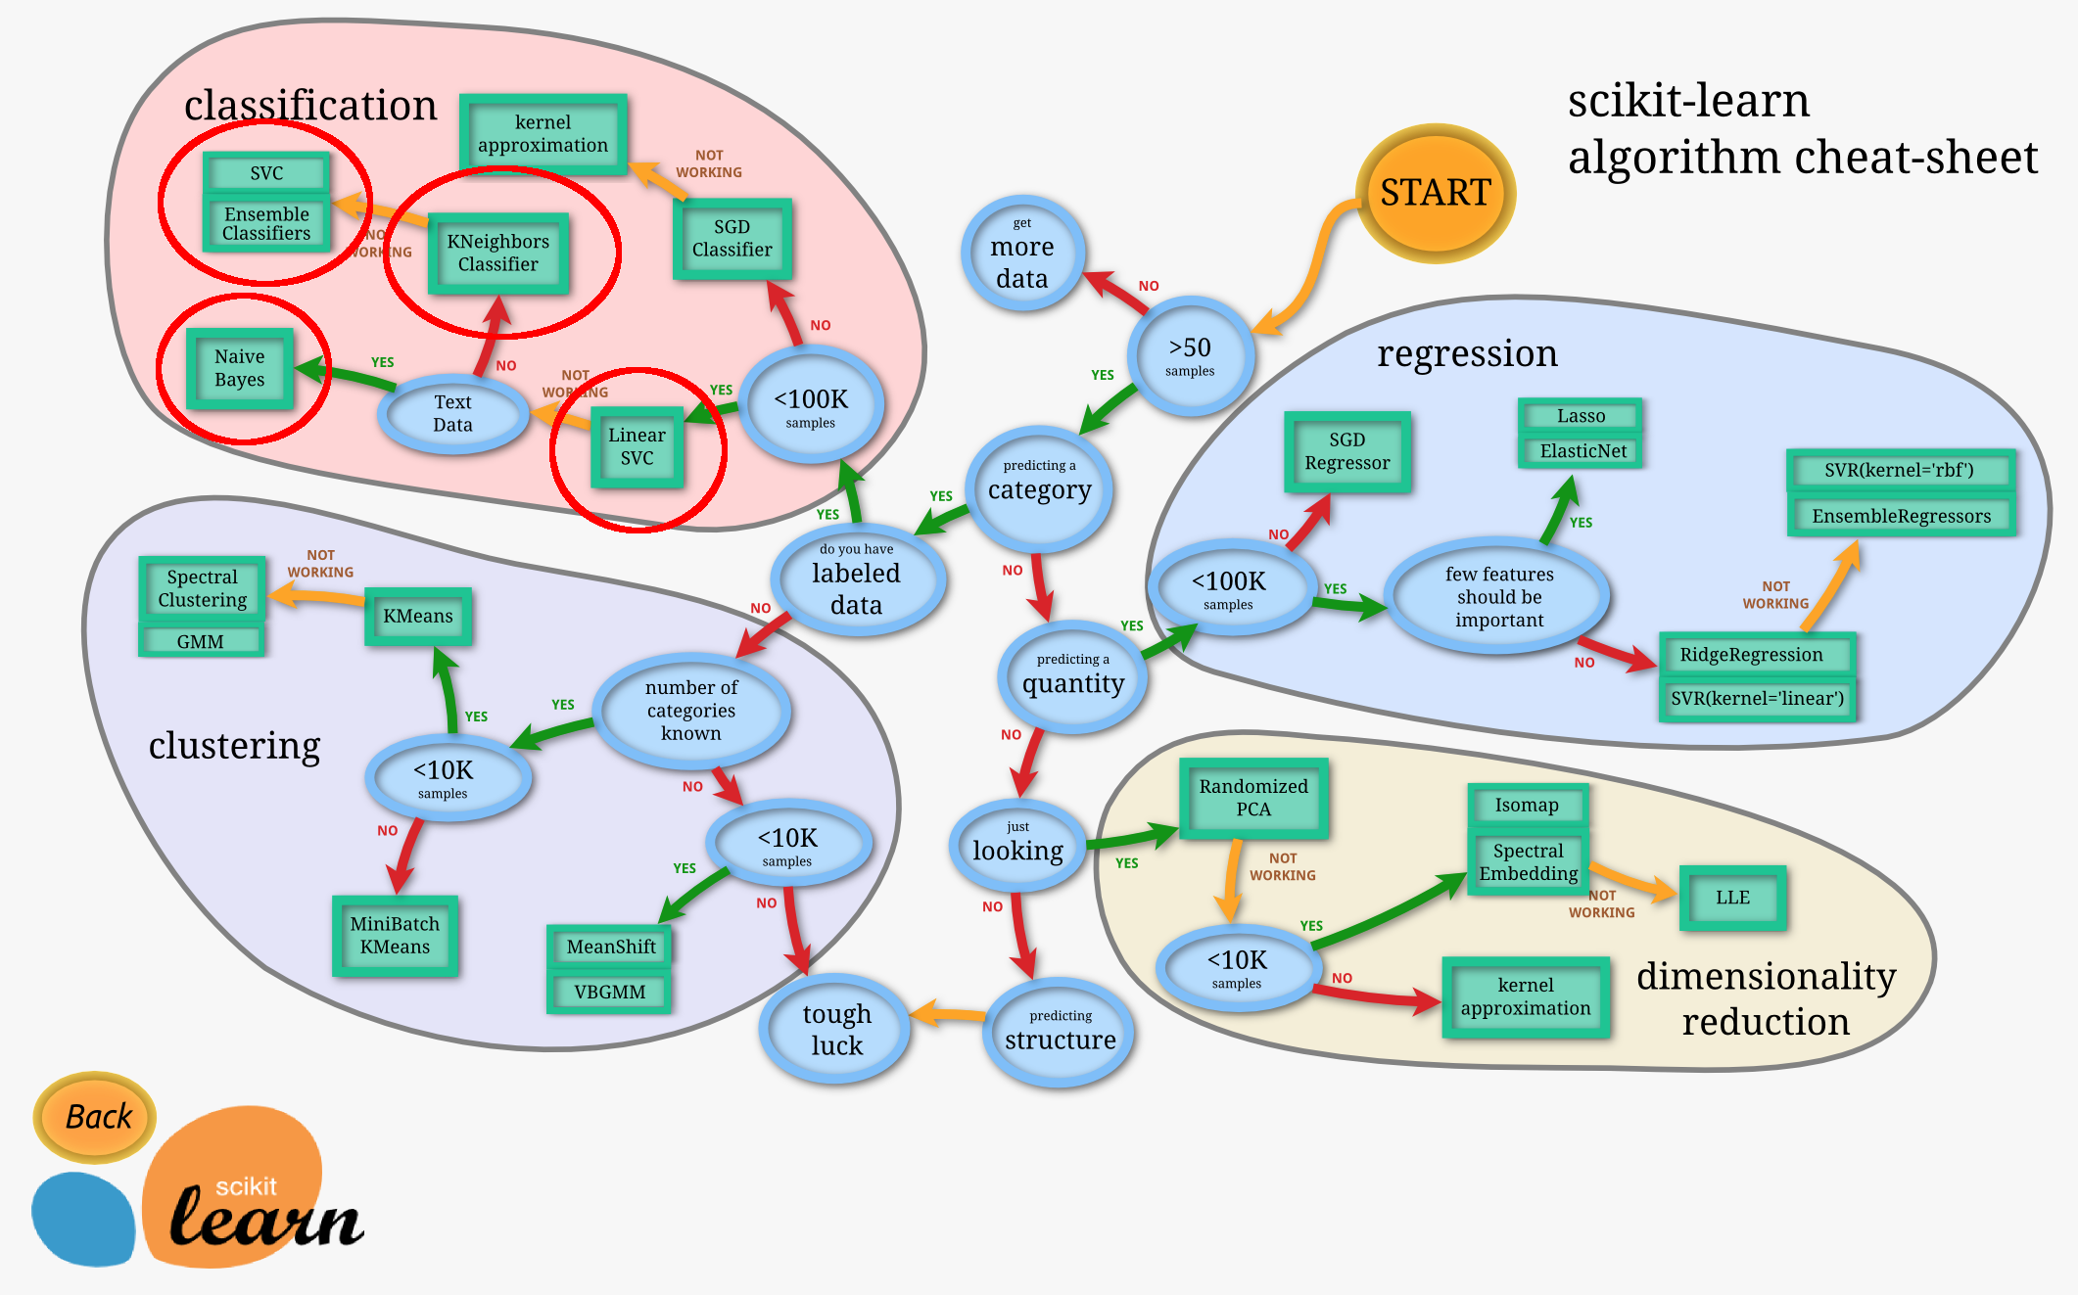
Notes:
7

Slide 8
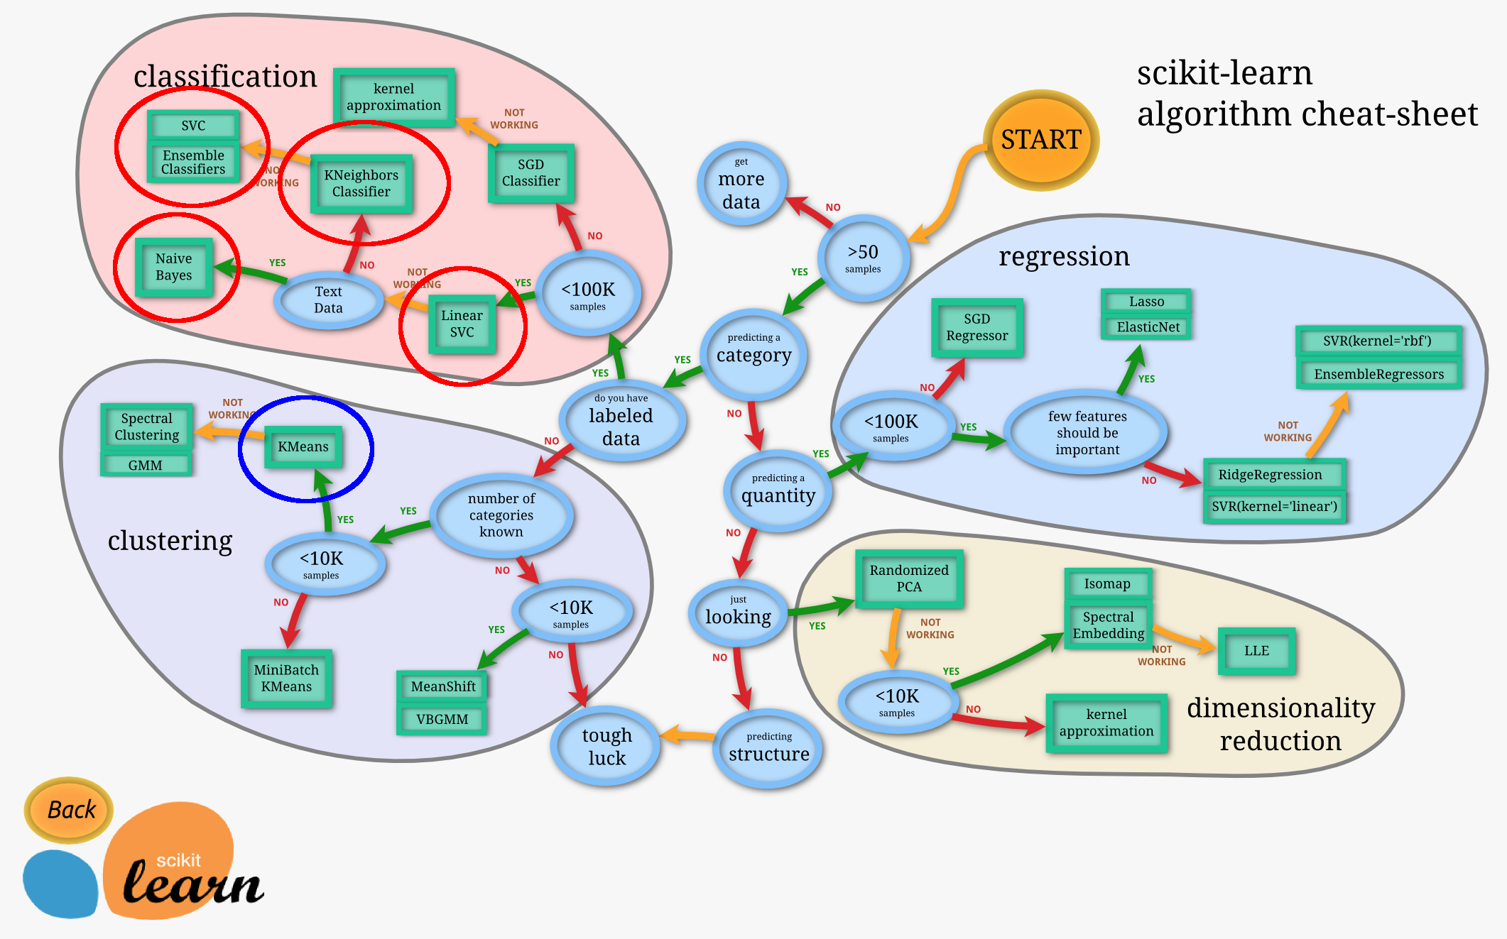
Notes:
8

Slide 9
Clustering Approach
Use TF-IDF as features
Cluster similar posts and predict 2 most frequent tags
Using GridSearch to find best number of clusters (→ #tags)
Model | Precision micro | Precision macro | Recall micro | Recall macro | F1 micro | F1 macro
HAC | 0.298 | 0.135 | 0.256 | 0.137 | 0.275 | 0.123
k-Means | 0.312 | 0.158 | 0.268 | 0.131 | 0.289 | 0.130
→ Used as (primitive) baseline for classification
Notes:
9

Slide 10
Text Classification Approach
Again, use TF-IDF as features
OneVsRestClassifier to predict 2 tags
Using GridSearch to find best parameters
Model | Precision micro | Precision macro | Recall micro | Recall macro | F1 micro | F1 macro
MultinomialNB alpha = 0.1 | 0.418 | 0.138 | 0.325 | 0.079 | 0.366 | 0.090
RandomForest n_estimators = 200 | 0.417 | 0.143 | 0.355 | 0.111 | 0.384 | 0.115
KNN n_neighbors = 10 | 0.429 | 0.227 | 0.357 | 0.205 | 0.390 | 0.199
Linear SVM C = 0.025 | 0.493 | 0.289 | 0.415 | 0.259 | 0.451 | 0.258
Notes:
10

Slide 11
Information Theoretical Classification Approach
Use 6 features for a document/tag pair (PMI…) instead of TF-IDF
Notes:
11

Slide 12
Information Theoretical Classification Approach
Use 6 features for a document/tag pair (PMI…) instead of TF-IDF
Tremendous improvement → outperforms previous text classification approach
Model | Precision micro | Precision macro | Recall micro | Recall macro | F1 micro | F1 macro
KNN n_neighbors = 10
Linear SVM C = 2.0 | 0.757 | 0.448 | 0.653 | 0.407 | 0.701 | 0.415
RandomForest n_estimators = 200 | 0.641 | 0.329 | 0.547 | 0.254 | 0.590 | 0.271
Bagging base_estimator = DecisionTree n_estimators = 40 | 0.779 | 0.617 | 0.675 | 0.534 | 0.723 | 0.559
Notes:
12

Slide 13
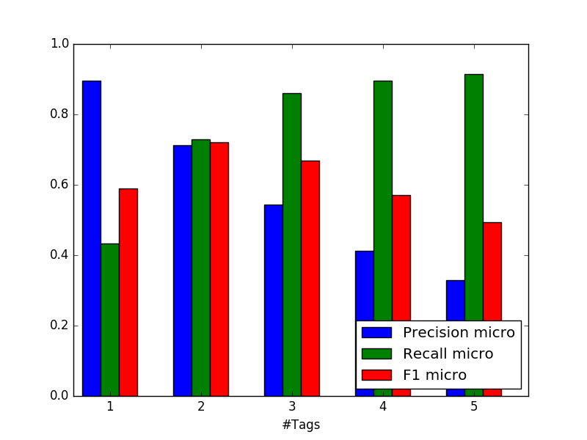
Finding Best Number of Suggested Tags

Slide 14
Conclusion
What have you learned?
Preprocessing is very important, but also takes a lot of effort
Feature Selection is (even more) important
Information theoretical features work much better than TFIDF
Micro average higher than macro
i.e. good prediction for frequent but not for infrequent tags
Reasons: Unbalanced data

Slide 15
Conclusion
Did something unexpected happen?
Running soon out of memory
32 GB of RAM not enough
→ Especially when using multi-processed GridSearch
Very time-intensive to compute
8 Cores not enough to terminate in reasonable amount of time
→ Especially when grid-searching for best hyperparameters

Slide 16
Outlook:
Improve preprocessing
Use different (more independent) features for Naïves Bayes
Evaluation
Use cost-sensitive classifier because some tags dominate
had some issues with rule-based POS-tagger → train supervised tagger instead
Neuronal Networks
Use unsupervised learning to detect outliers as preprocessing for supervised
Better stemmer

Slide 17
Thank you for your attention.
References:
Knowledge Discovery and Data Mining 1 by Denis Helic and Roman Kern (2015)
Segaran, T. 2007. Programming Collective Intelligence: Building Smart Web 2.0 Applications. Sebastopol: O‘Really
Schuster, S., Zhu, W., Cheng, Y. Predicting Tags for StackOverflow Questions. Stanford University

